Slide 1
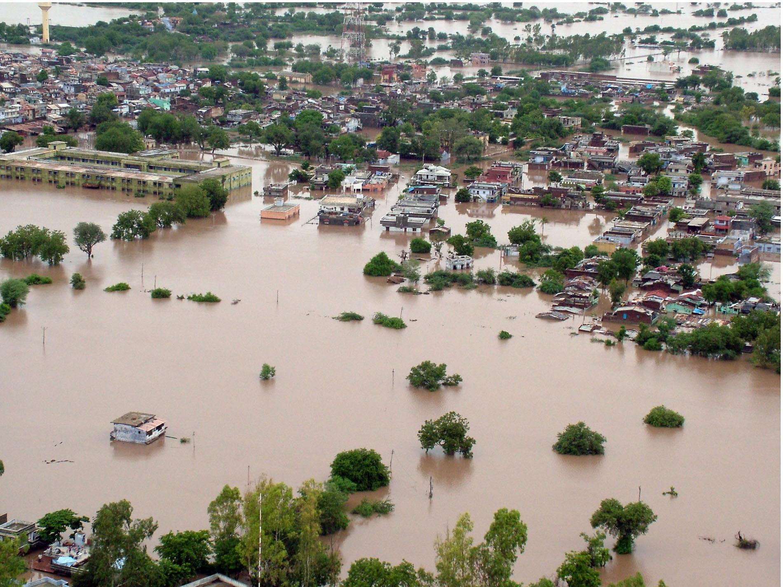
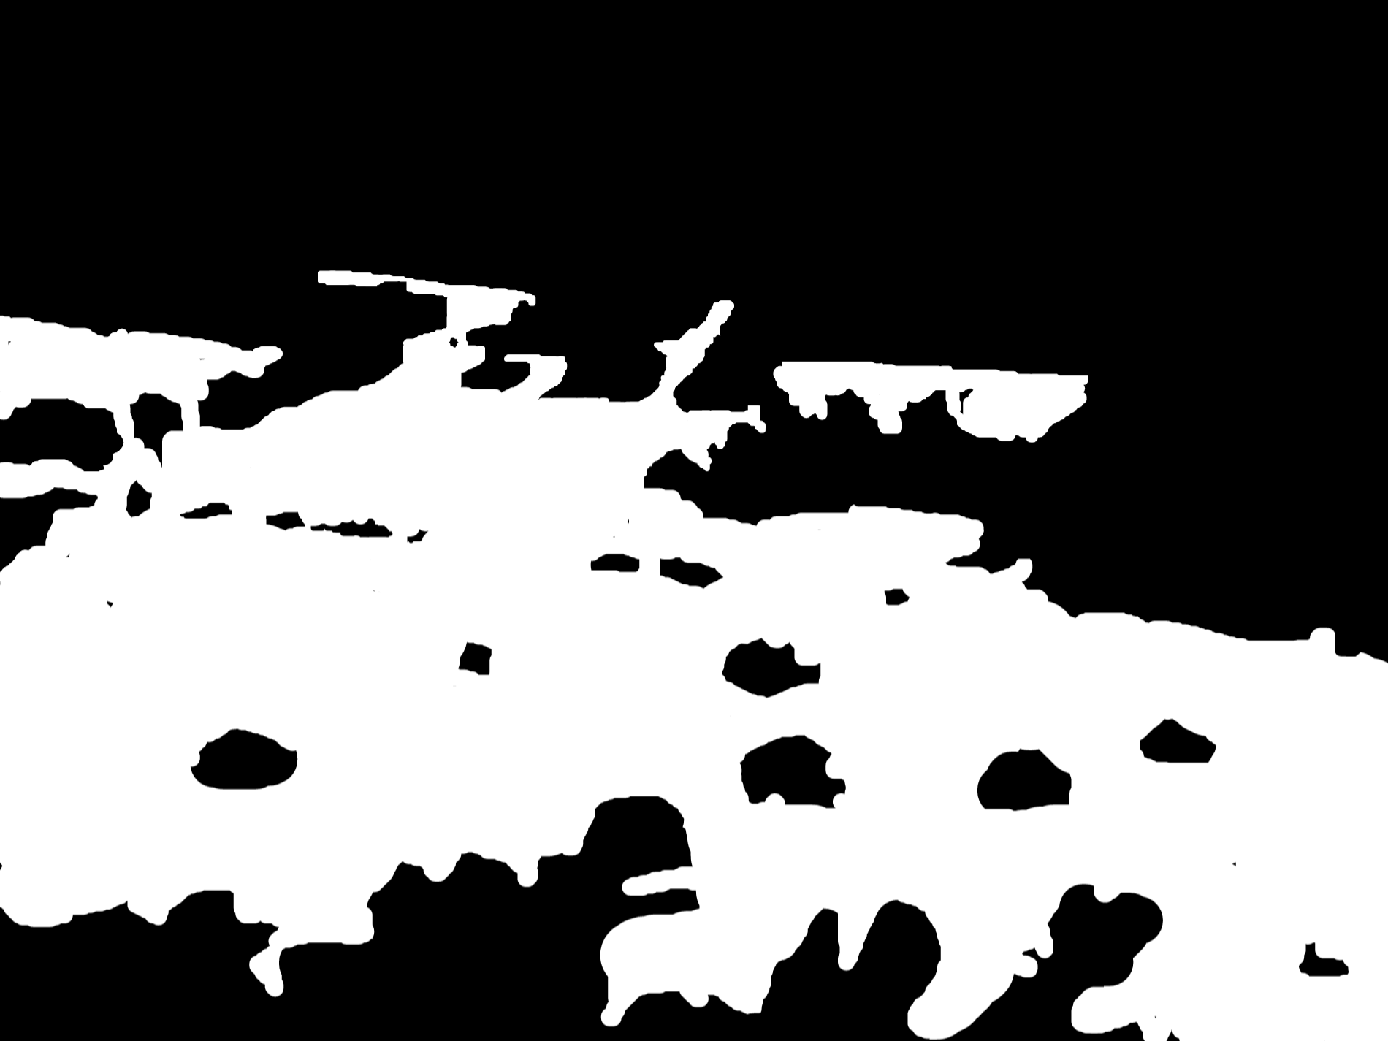
Flood Impact Detection on Roads Using U-Net
Shaoun Chandra Shill Fahim Ahmed ifty
23373005 23266007
Tuhin Ahmed Effat Jahan
23173004 24366047
GROUP - 06

Slide 2
Project Idea
Design a U-net model for the classification and segmentation of parts of road images in Bangladesh affected by flood. This would be useful for evaluating the effects of floods on road construction as a way of determining the extent of damage in areas that experience flood ravages during certain seasons of the year. Segment out flooded region of roads in Bangladesh using satellite images or from any aerial view.

Slide 3
Project Related Paper
U-Net: Convolutional Networks for Biomedical Image Segmentation. link - https://doi.org/10.48550/arXiv.1505.04597
Image Segmentation Methods for Flood Monitoring System. link - https://doi.org/10.3390/w12061825
Road Extraction by Deep Residual U-Net. link- https://arxiv.org/pdf/1711.10684
Satellite Image Segmentation for Building Detection using U-net. link - https://cs229.stanford.edu/proj2017/final-reports/5243715.pdf

Slide 4
Project Dataset
Flood Area Segmentation
Link : https://www.kaggle.com/datasets/faizalkarim/flood-area-segmentation

Slide 5
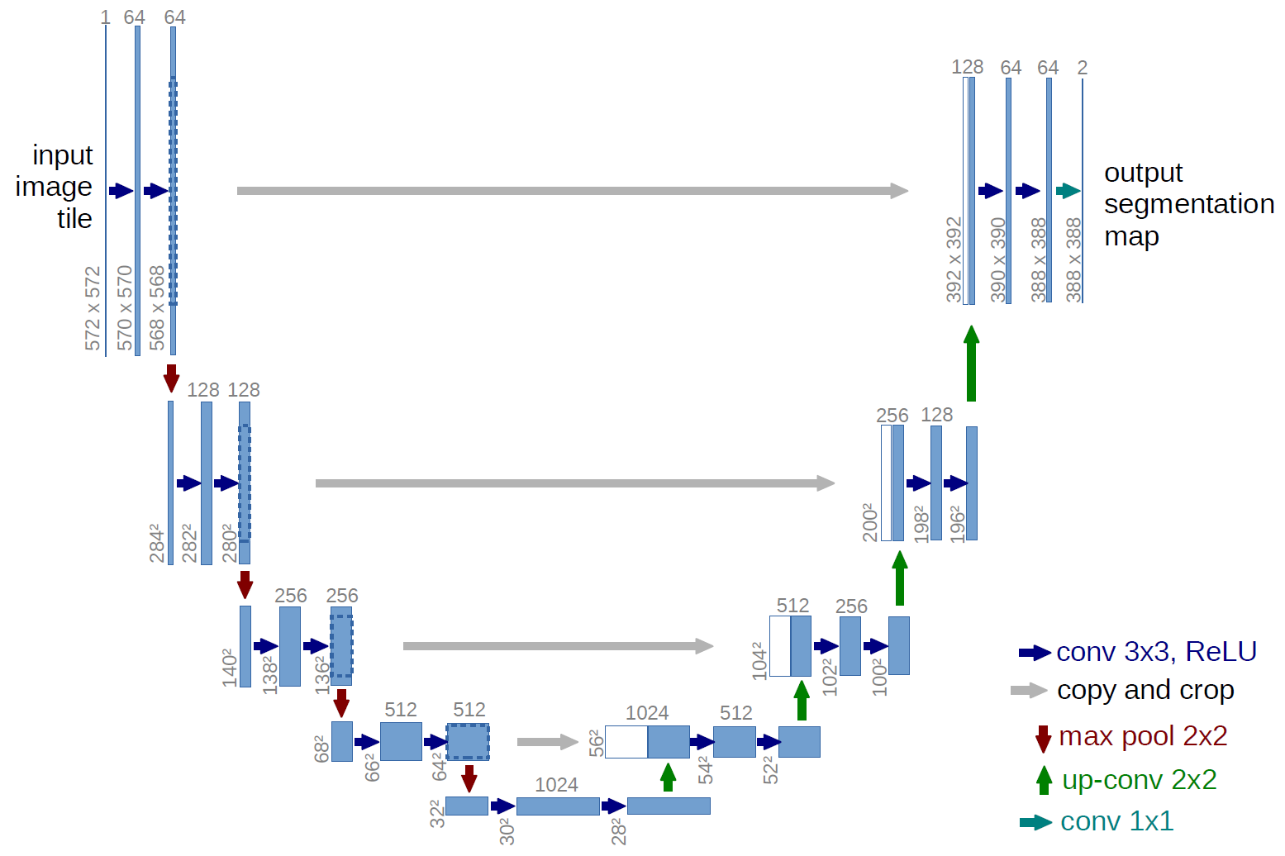
Unet Architecture
U-net was originally invented and first used for image segmentation. Its architecture can be broadly thought of as an encoder network followed by a decoder network.

Slide 6
What is the Unet Architecture

Slide 7
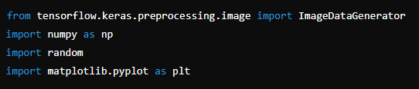
Data Clean
Importing the Required Libraries -
- ImageDataGenerator: Used for real-time data augmentation. This will apply various transformations to the image and mask during training.
- numpy (np): This library is used for array operations.
- random: Used to generate random integers.
- matplotlib.pyplot: A popular library for plotting images and other graphical data.

Slide 8
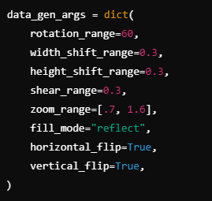
Data Augmentation for Images and Masks
- rotation_range: Randomly rotate the image by up to 60 degrees.
- width_shift_range and height_shift_range: Shift the image horizontally or vertically by up to 30% of the total width or height.
- shear_range: Shearing the image to 30%, distorting it in a linear direction.
- zoom_range: Randomly zoom into the image, with a minimum zoom of 0.7x and a maximum zoom of 1.6x.
- fill_mode="reflect": The empty areas after rotation, shifting, or shearing will be filled with a reflection of the image.
- horizontal_flip and vertical_flip: Flip the image horizontally and vertically randomly.

Slide 9
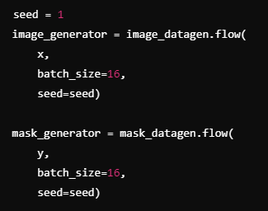
Creating Image and Mask Generators
- x: Input image dataset.
- y: Input mask dataset.
- batch_size: Number of images to generate per batch (in this case, 16).
- seed: Ensures that the same random transformations are applied to both the image and its corresponding mask.

Slide 10
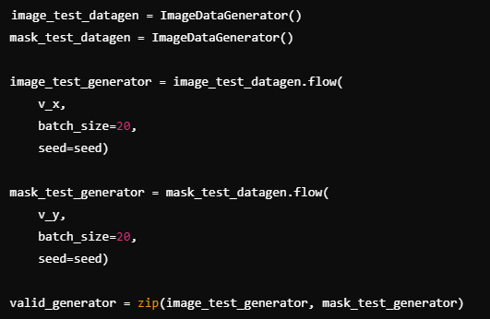
Validation Data Generators (Without Augmentation)
- image_test_datagen and mask_test_datagen: Data generators without augmentation. These are used for validation data (`v_x` for images and `v_y` for masks).
- valid_generator: A zip object that pairs the images and their corresponding masks, useful for model validation.

Slide 11
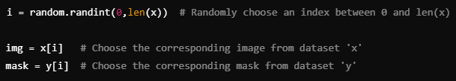
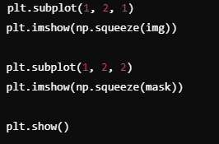
Visualizing a Randomly Selected Image and Mask
- plt.subplot(1, 2, 1): Sets up the subplot for displaying the image on the left.
- plt.subplot(1, 2, 2): Sets up the subplot for displaying the mask on the right.
- plt.imshow(np.squeeze(img)): Visualizes the randomly selected image by removing extra dimensions.
- plt.imshow(np.squeeze(mask)): Visualizes the corresponding mask.
- plt.show(): Displays the images side-by-side.

